Slide 1
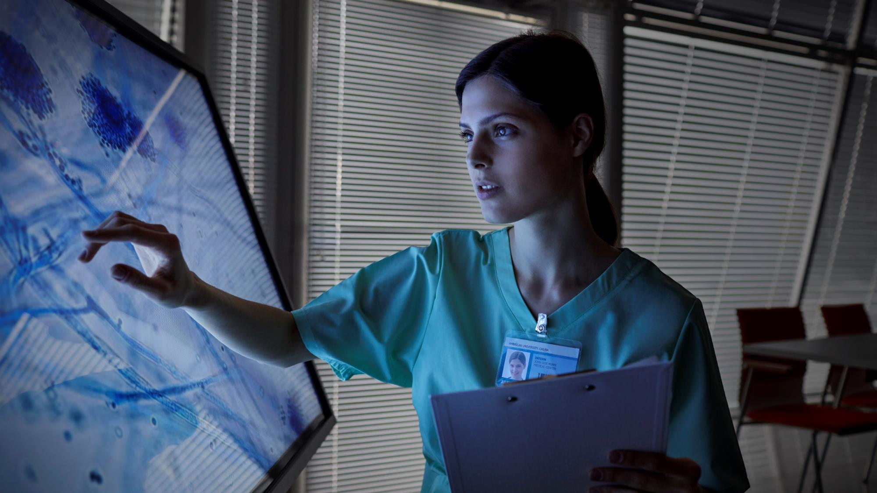

Prediction and Detection of Cancer Disease Using Machine Learning
YANAMADALACHANDRA SHEKAR 2011CS020435
GUIDED BY: Prof. RAJESHWARI

Slide 2

ABSTRACT
Machine learning is used in almost all the medical fields by the diagnostics and doctors especially in predicting and detecting the risk of cancer. This growing trend of machine learning utilization in this approach enables the researchers to survey on the various types and approaches of machine learning . Machine learning is increasingly being employed in cancer detection and diagnosis. Cancer prediction will become quite easy in the future and we can predict it without the need of going to the hospitals. As we can see many technologies are being used and tested in the medical field. So, by this we can say that this will make us easier in the future to detect cancer.

Slide 3

INTRODUCTION
Problem Definition:
Prediction and Detection of Cancer disease in Human beings Using Machine Learning.
OBJECTIVE:
❖ Disease will be predicted using Naive Bayesian algorithm which works on probabilistic approach more specifically Multinomial NB since multiple symptoms are taken.
❖ The goal is to classify whether the cancer is benign or malignant. To achieve this we have used machine learning classification methods to fit a function that can predict the discrete class of new input.

Slide 4
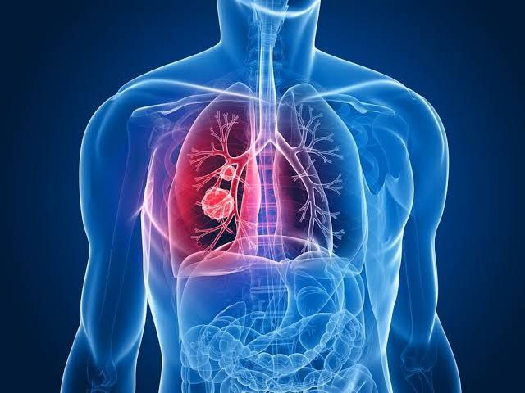
SOFTWARE REQUIREMENTS
• SOFTWARE REQUIREMENTS
➢Jupyter Notebook
➢Google Colaboratory
➢ Pycharm
VS Code
HARDWARE REQUIREMENTS
➢8 GB RAM
➢128 GB ROM
➢ PROCESSOR ABOVE 1.4 GHz

Slide 5

EXISTING SYSTEM
✓ Because of high quantity data in CT images and blurred boundaries, tumor segmentation and classification is very hard.
✓ In MR images, the amount of data is too much for manual interpretation and analysis.
PROPOSED SYSTEM
✓This work as automatic cancer detection method to increase the accuracy and yield and decrease the diagnosis time.
✓The goal is classifying the tissues to three classes of normal, benign and malignant.
✓Accurate detection of size and location of cancer plays a vital role in the diagnosis of cancer.

Slide 6
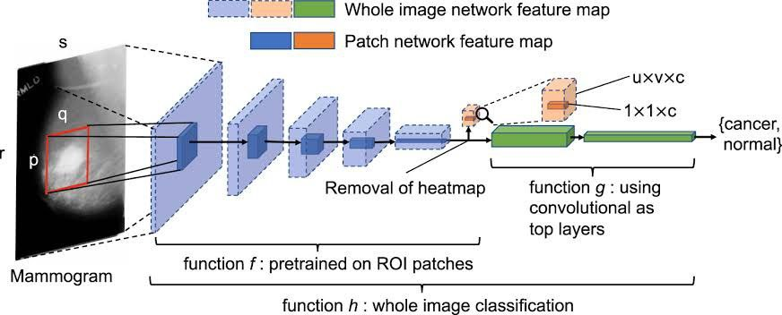
MODULES:
Naïve Bayesian
Scikit-learn
Keras
Tensor flow

Slide 7
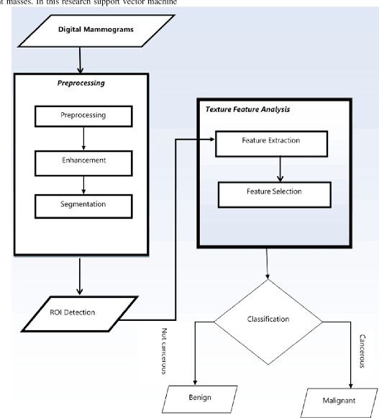
Architecture

Slide 8
conclusion
Cancer has become a threat to life, so it is important to diagnose the cancer in initial stages for proper treatment. Nowadays, many machine learning approaches are used to classify the tumour cells correctly. This paper demonstrates that neural network technology is very effective in detection of cancer and has given motive to dig deeper into the concept of ANN.

Slide 9

Thank you
Mirjam Nilsson
E

